Slide 1

Geosynchronous Amateur Radio Satellites
Wally Ritchie - WU1Y
Michelle Thompson – W5NYV
Open Research Institute

Slide 2

View of NA From Geo
Notes:
This is what the Earth, Moon, and Sun look from GEO. Relative size of the Sun and Moon are the same as from the Earth.

Slide 3
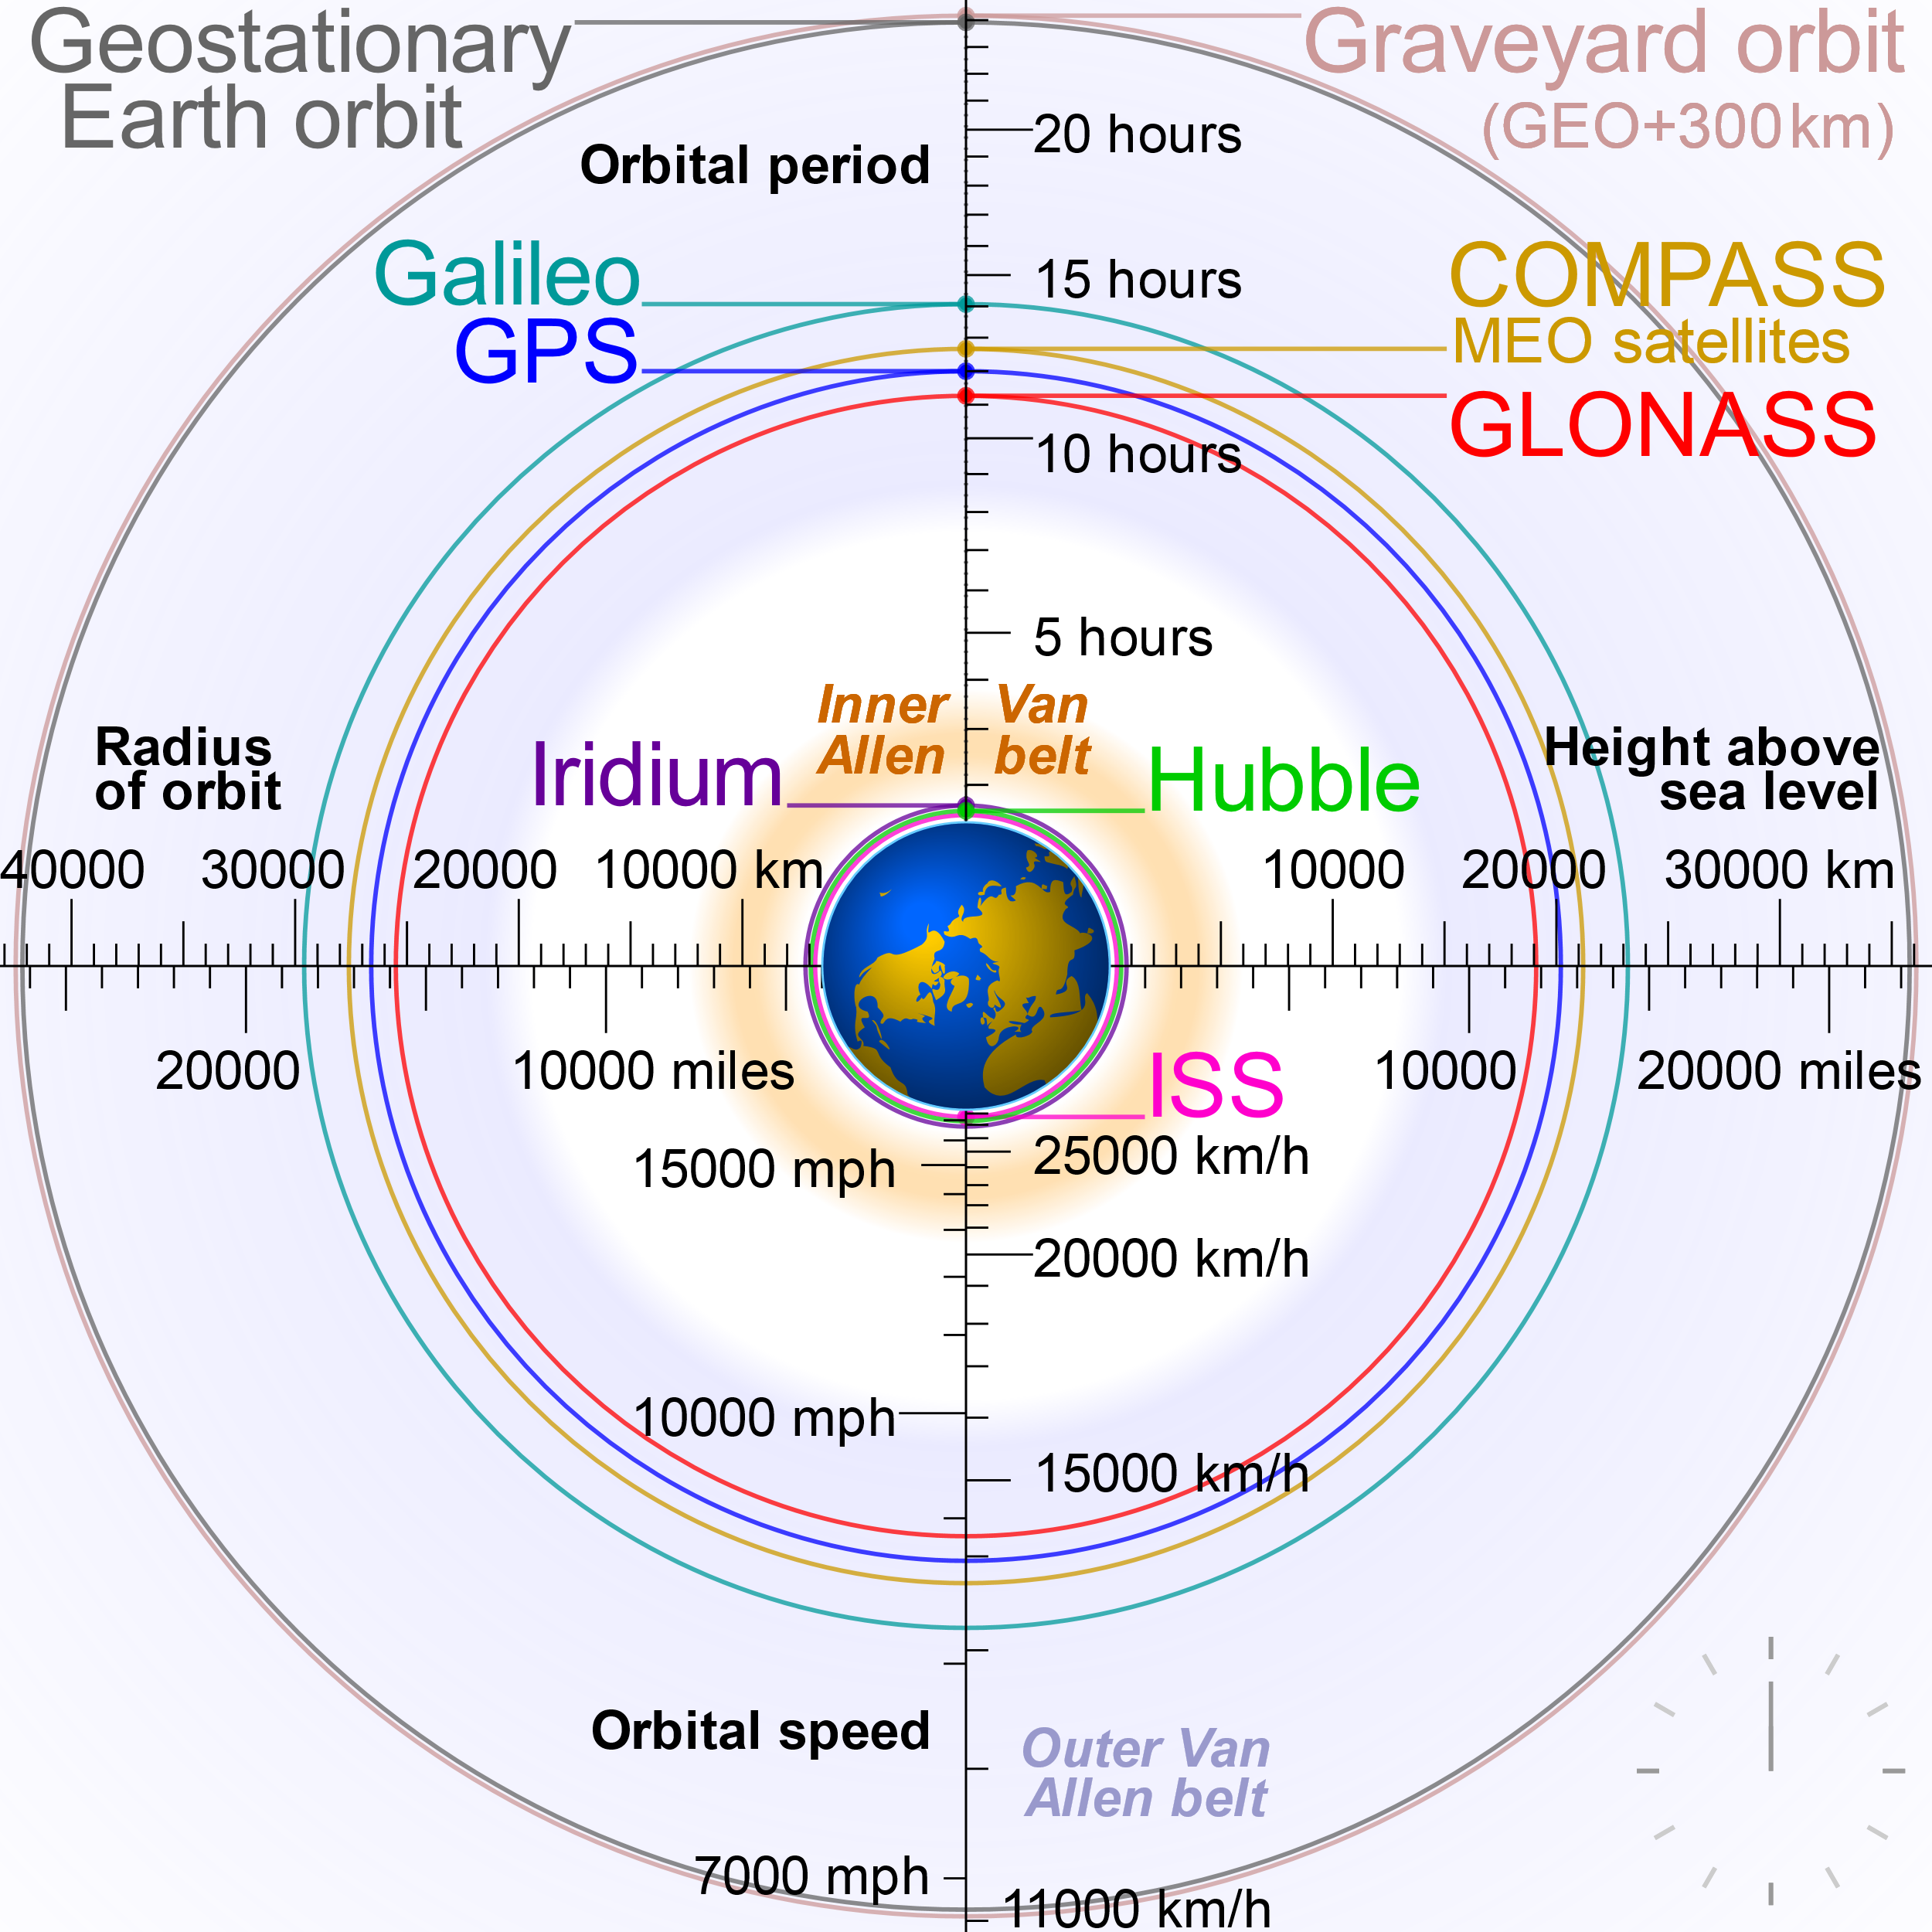
By cmglee - Own work, CC BY-SA 3.0, https://commons.wikimedia.org/w/index.php?curid=16891766
Notes:
These are the lreative heights of various orbits. Not that ISS is barely above the earth. GPS satellites are in mid order of about 12 hours.

Slide 4

Notes:
Relative Orbits. Dotted Red is ISS. Blue is LEO. Dotted green is GPS. Outer broken black line is GEO

Slide 5
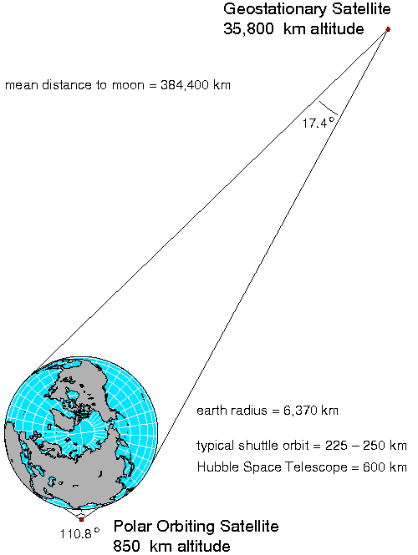
GEOMETRY
Notes:
Geometry. The earth occupies 17.4 degrees of the field of view from GEO

Slide 6
AMSAT PHASE 4 and 5
PHASE 4 – Geosynchronous Satellites
Phase 4A – AMSAT-DL Rideshare on Es-hail-2 Launched on November 15, 2018
Phase 4B – Rideshares under negotiation, WFOV didn’t work out because of reduction of capability, increase in the cost to AMSAT, and delays in the launch due to primary payload schedule.
Phase 4X – engineering efforts from ORI are funded, rides to be scheduled, negotiations begun.
PHASE 5 – Lunar Orbit and Beyond
Cube-Sat Challenge – RAGNAROK INDUSTRIES/AMSAT Team Winners will Launch on EM-1 (2019)
Team Not among finalists.
LOP-G (Lunar Gateway ) Active work and a lot of progress! System design largely the same as Phase 4 Ground and Space and there are efforts to ensure compatibility with SATNOGs.

Slide 7
PHASE 4A: AMSAT-DL Es’hail 2
Geostationary Orbit at 25.5˚E over Europe & Middle East
Hosted Payload w/Qatar Satellite Company’s Es-Hail 2
Coverage – Europe, Africa, Middle-east, Thailand to Eastern tip of Brazil
2.4GHz Uplink – 10GHz Downlink
Two Linear 140W Transponders:
8 MHz for DVB Television and Data
250 kHz for Traditional SSB, CW, etc.

Slide 8
Es’hail-2 (QO-100)
Notes:
In the background is the Es’hail-2 Satellite and representatives from Mitsubishi Electric (the manufacturer) and EshailSat the satellite owner.

Slide 9
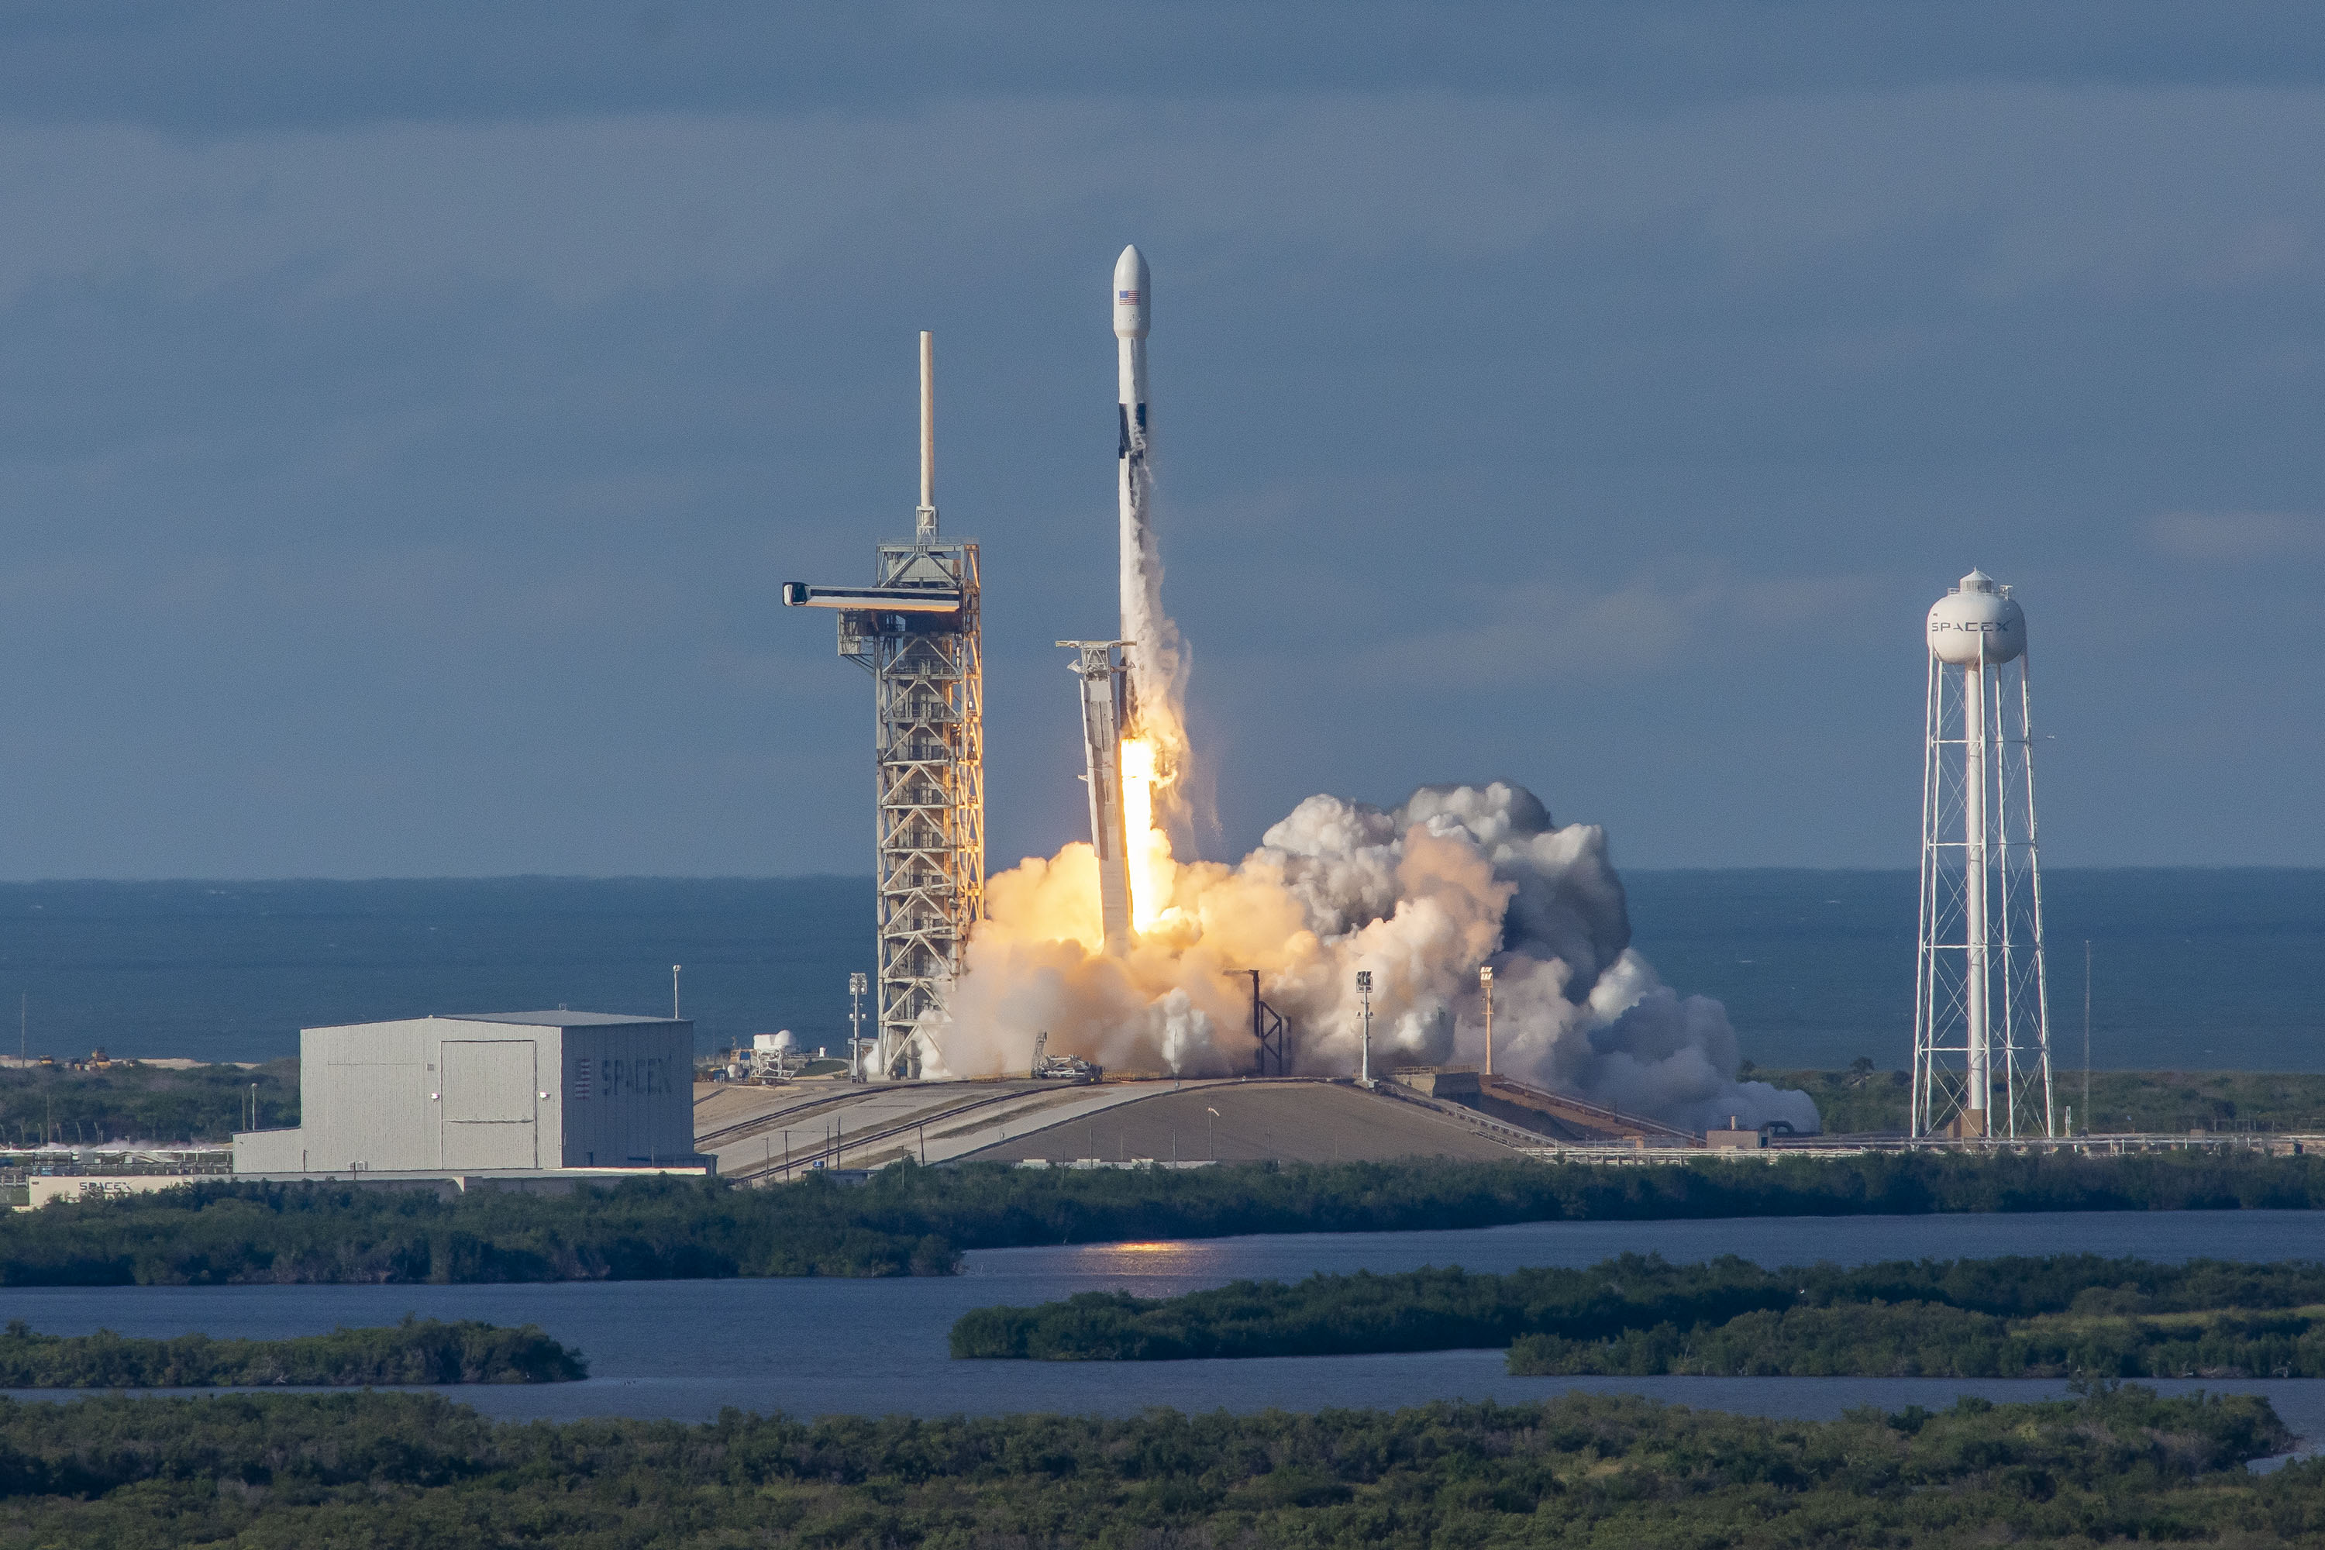
Es’Hail-2 Launch (Falcon 9)

Slide 10
4A – Coverage Area
Notes:
Commercial Coverage for the satellite uses various spot beams. The 10.5 GHz downlink, however, uses a global beam.
The green line is the 10 degree elevation and the redline is 5 degrees.

Slide 11
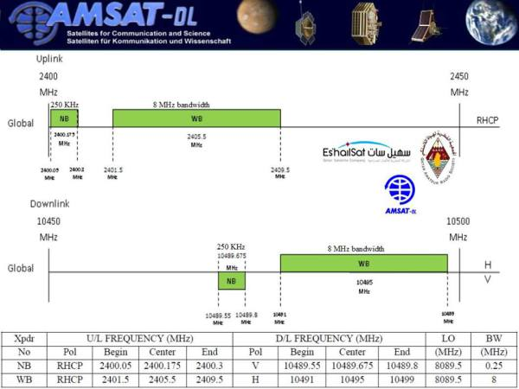
PHASE 4A Frequency Plan
Notes:
The S Band uplinks are shown in the top.
The X band downlinks are shown in the bottom.
Note that RHCP is used on the uplinks to match existing conventions.
The downlink uses horizontal polarization for the wideband uplink and vertical for the narrowband uplink.

Slide 12
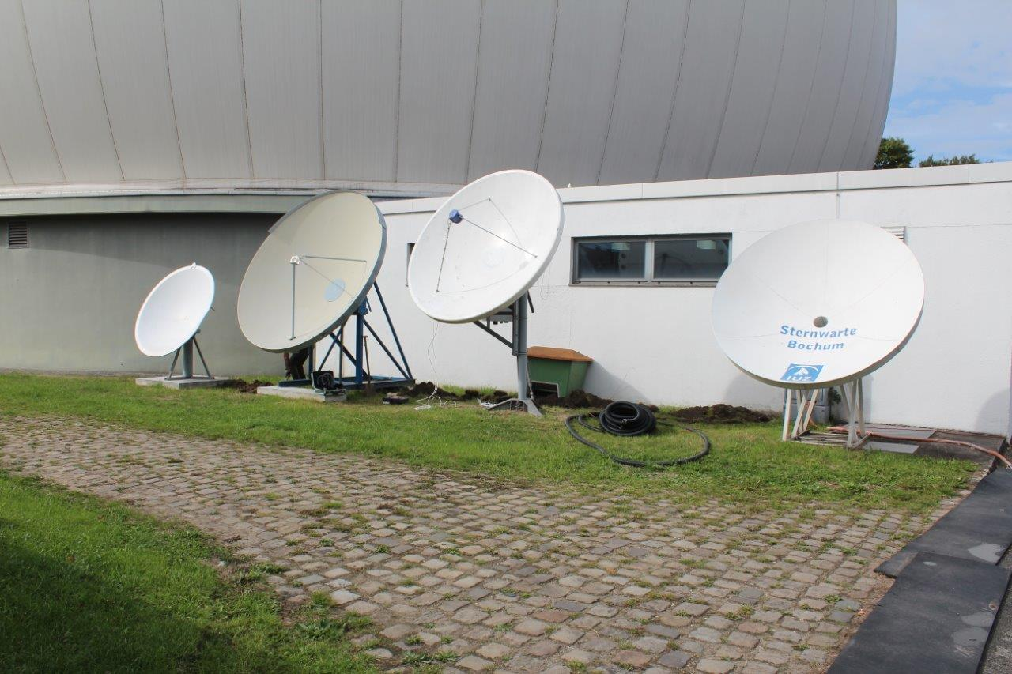
AMSAT-DL Bochum
Notes:
The Bochum Earth Station can provide the DVB-S2 Beacon uplink.

Slide 13
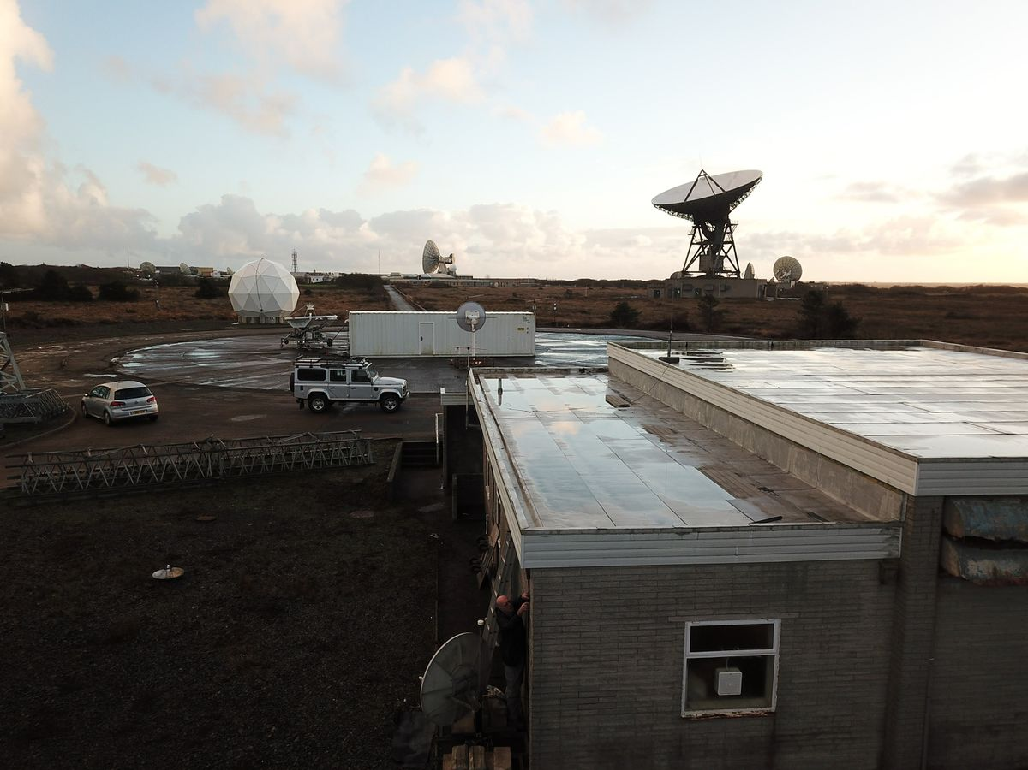
GoonHilly Site (UK)

Slide 14
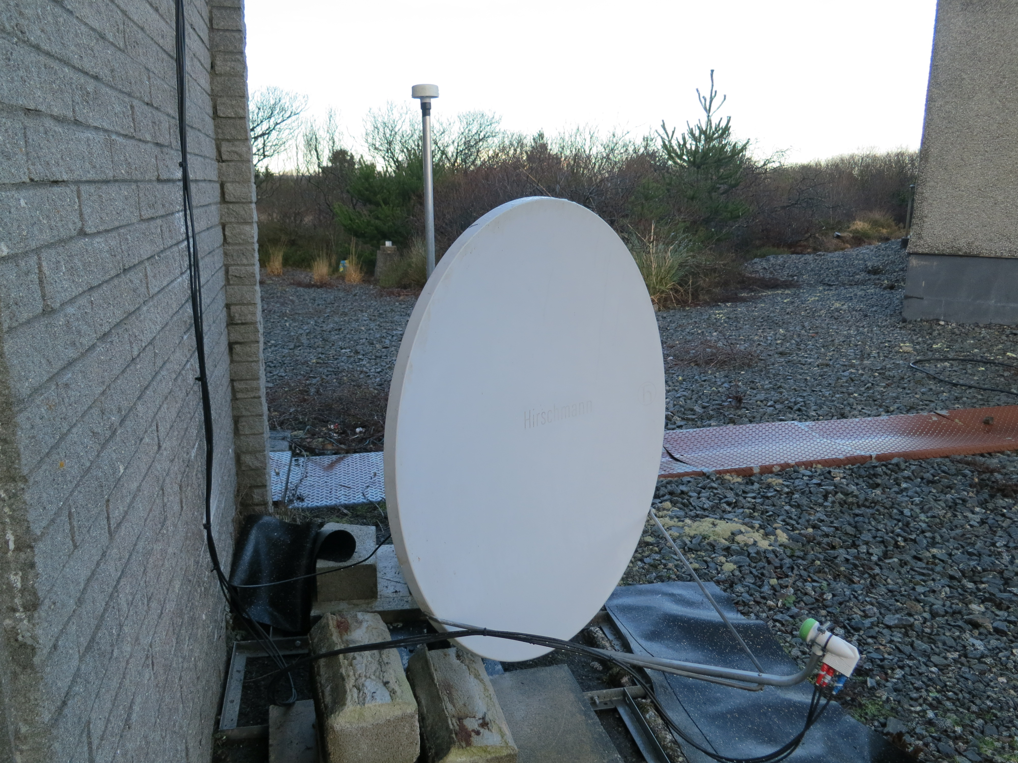
Goonhilly Dish

Slide 15
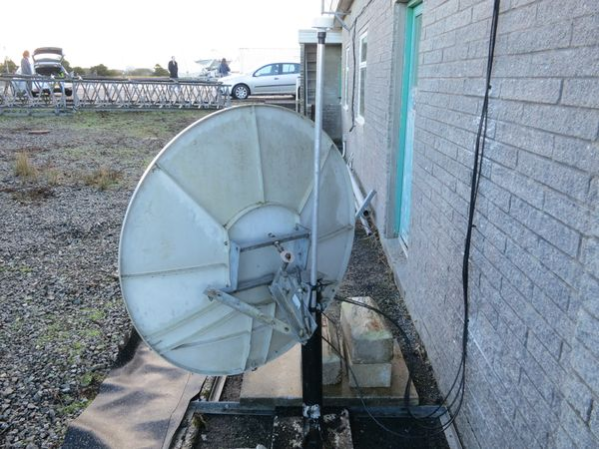
Back of Dish

Slide 16
BATC WebSDR Links
Narrowband websdr:
https://eshail.batc.org.uk/nb/
Wideband websdr:
https://eshail.batc.org.uk/wb/

Slide 17
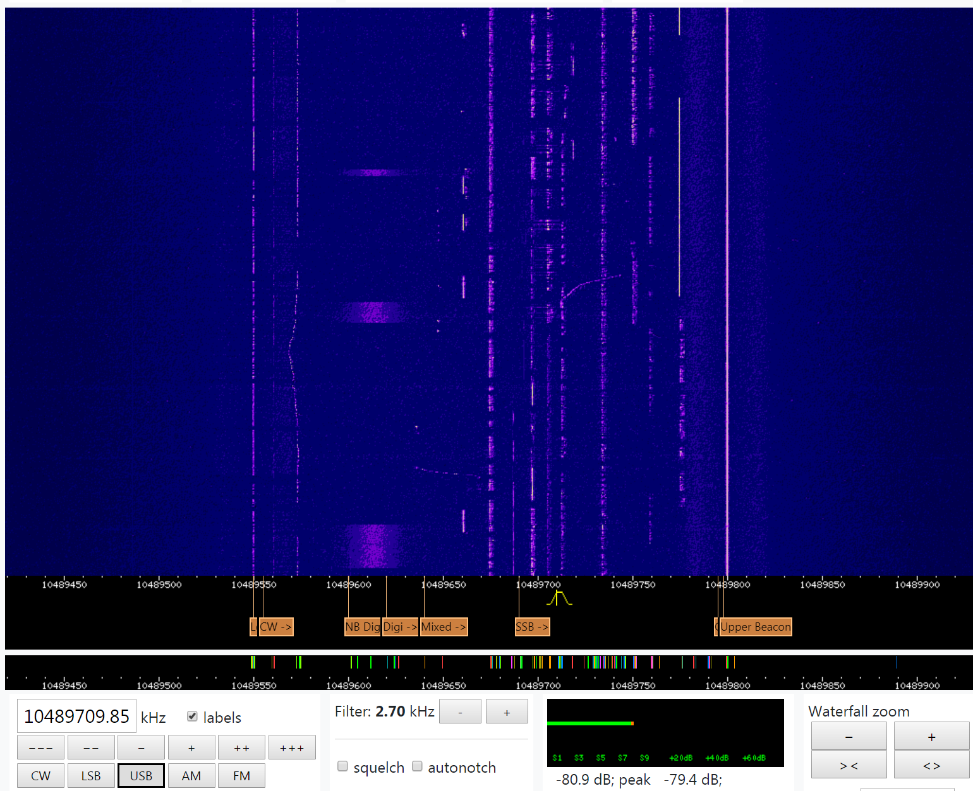
Narrow-Band Waterfall

Slide 18
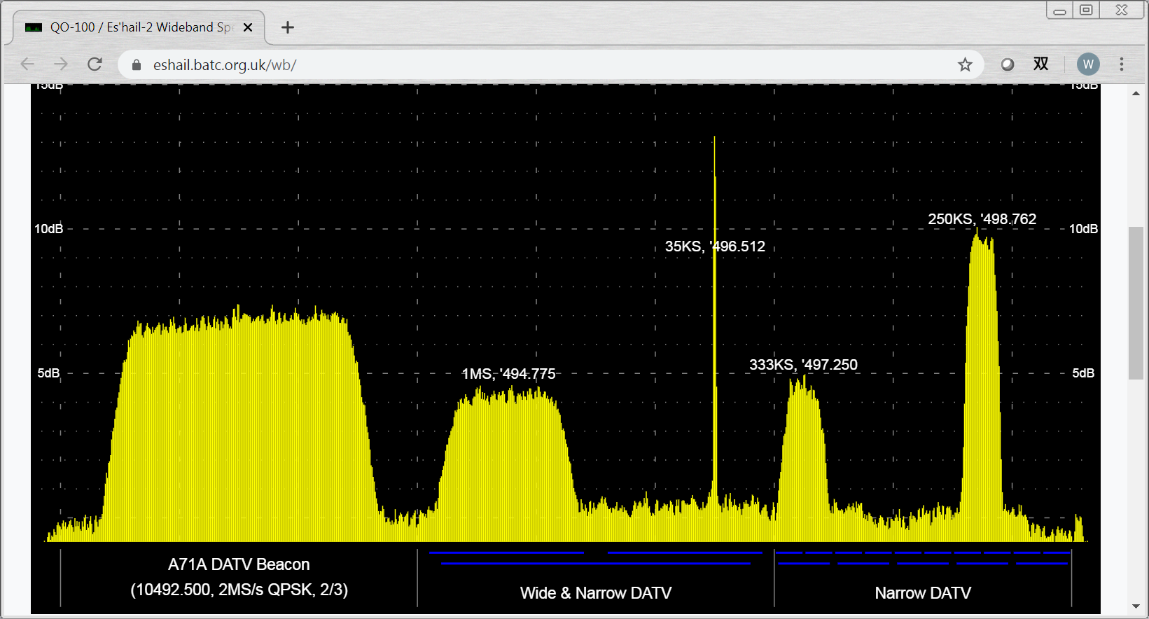

Slide 19
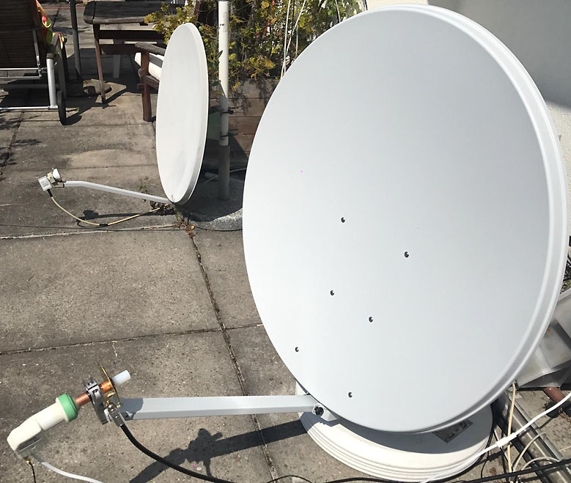
Tx/Rx Dish

Slide 20
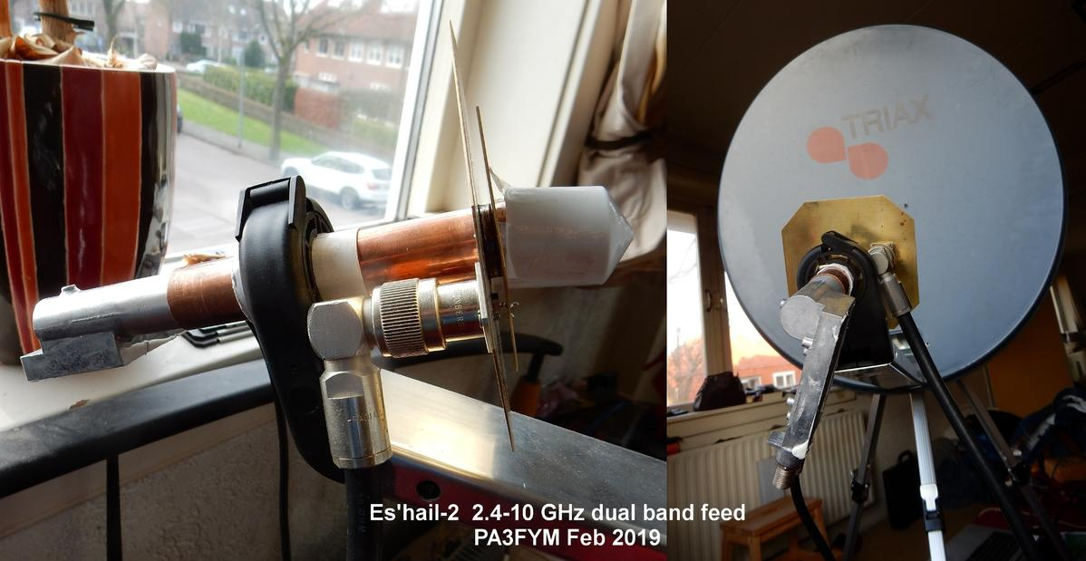
Dual Band Feed

Slide 21
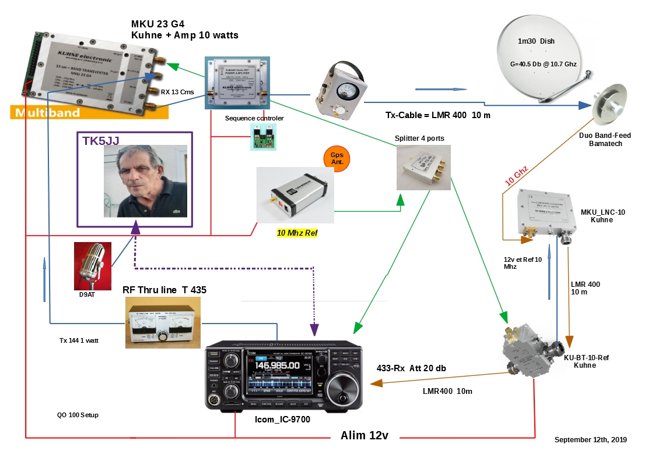
Typical Station TK5JJ
Notes:
TK5JJ is located in Corsica

Slide 22
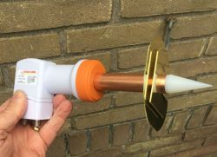
Patch of the Year (POTY)

Slide 23
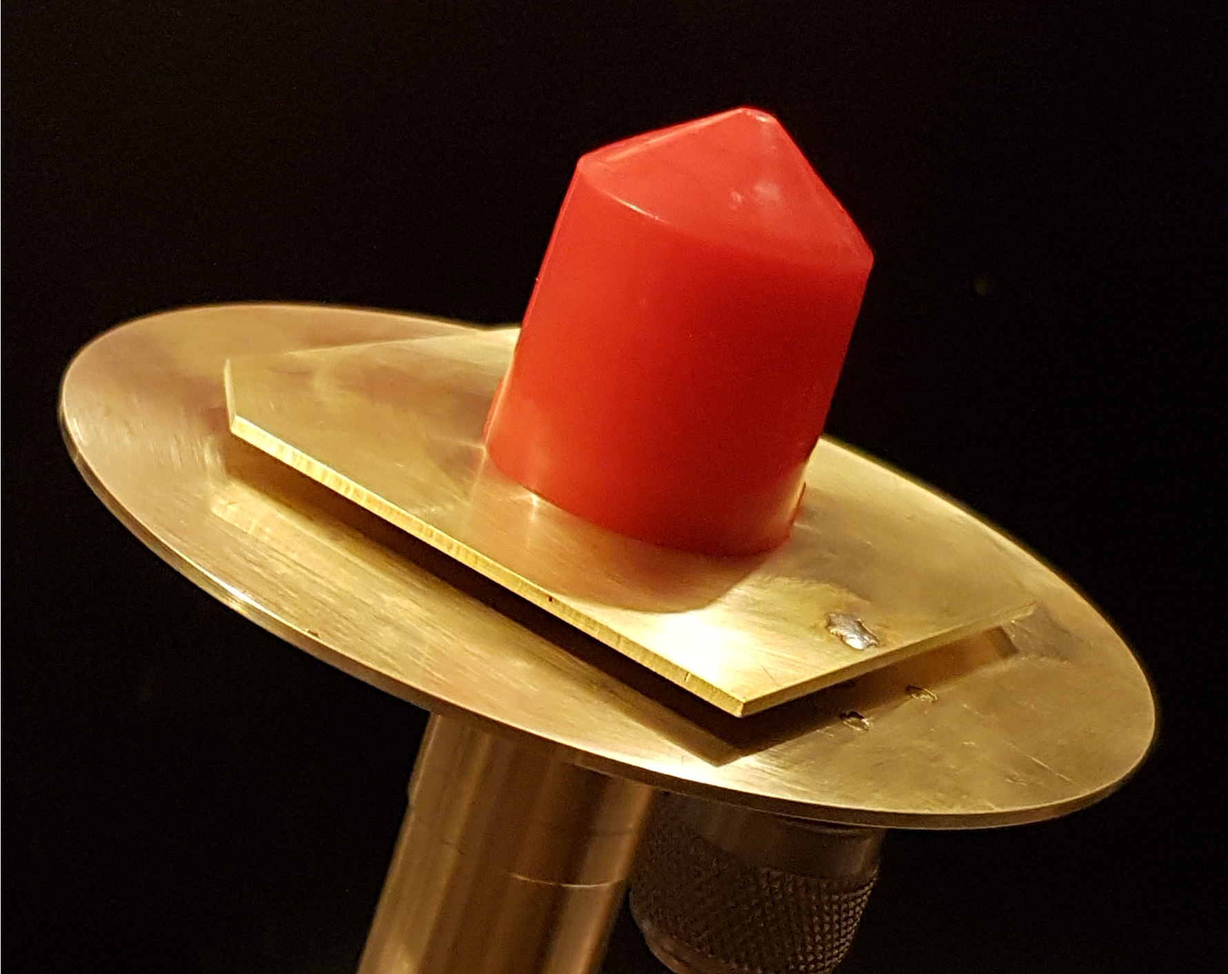
Dual Band Patch (Closeup)

Slide 24
PHASE 4B:
Rideshare on USAF Wide Field of View (WFOV) Geosynchronous Satellite
Partners
AMSAT, Millennium Space Systems, Virginia Tech
Rincon Research Corporation, ARRL, FEMA
Geosynchronous Orbit over North America

Slide 25
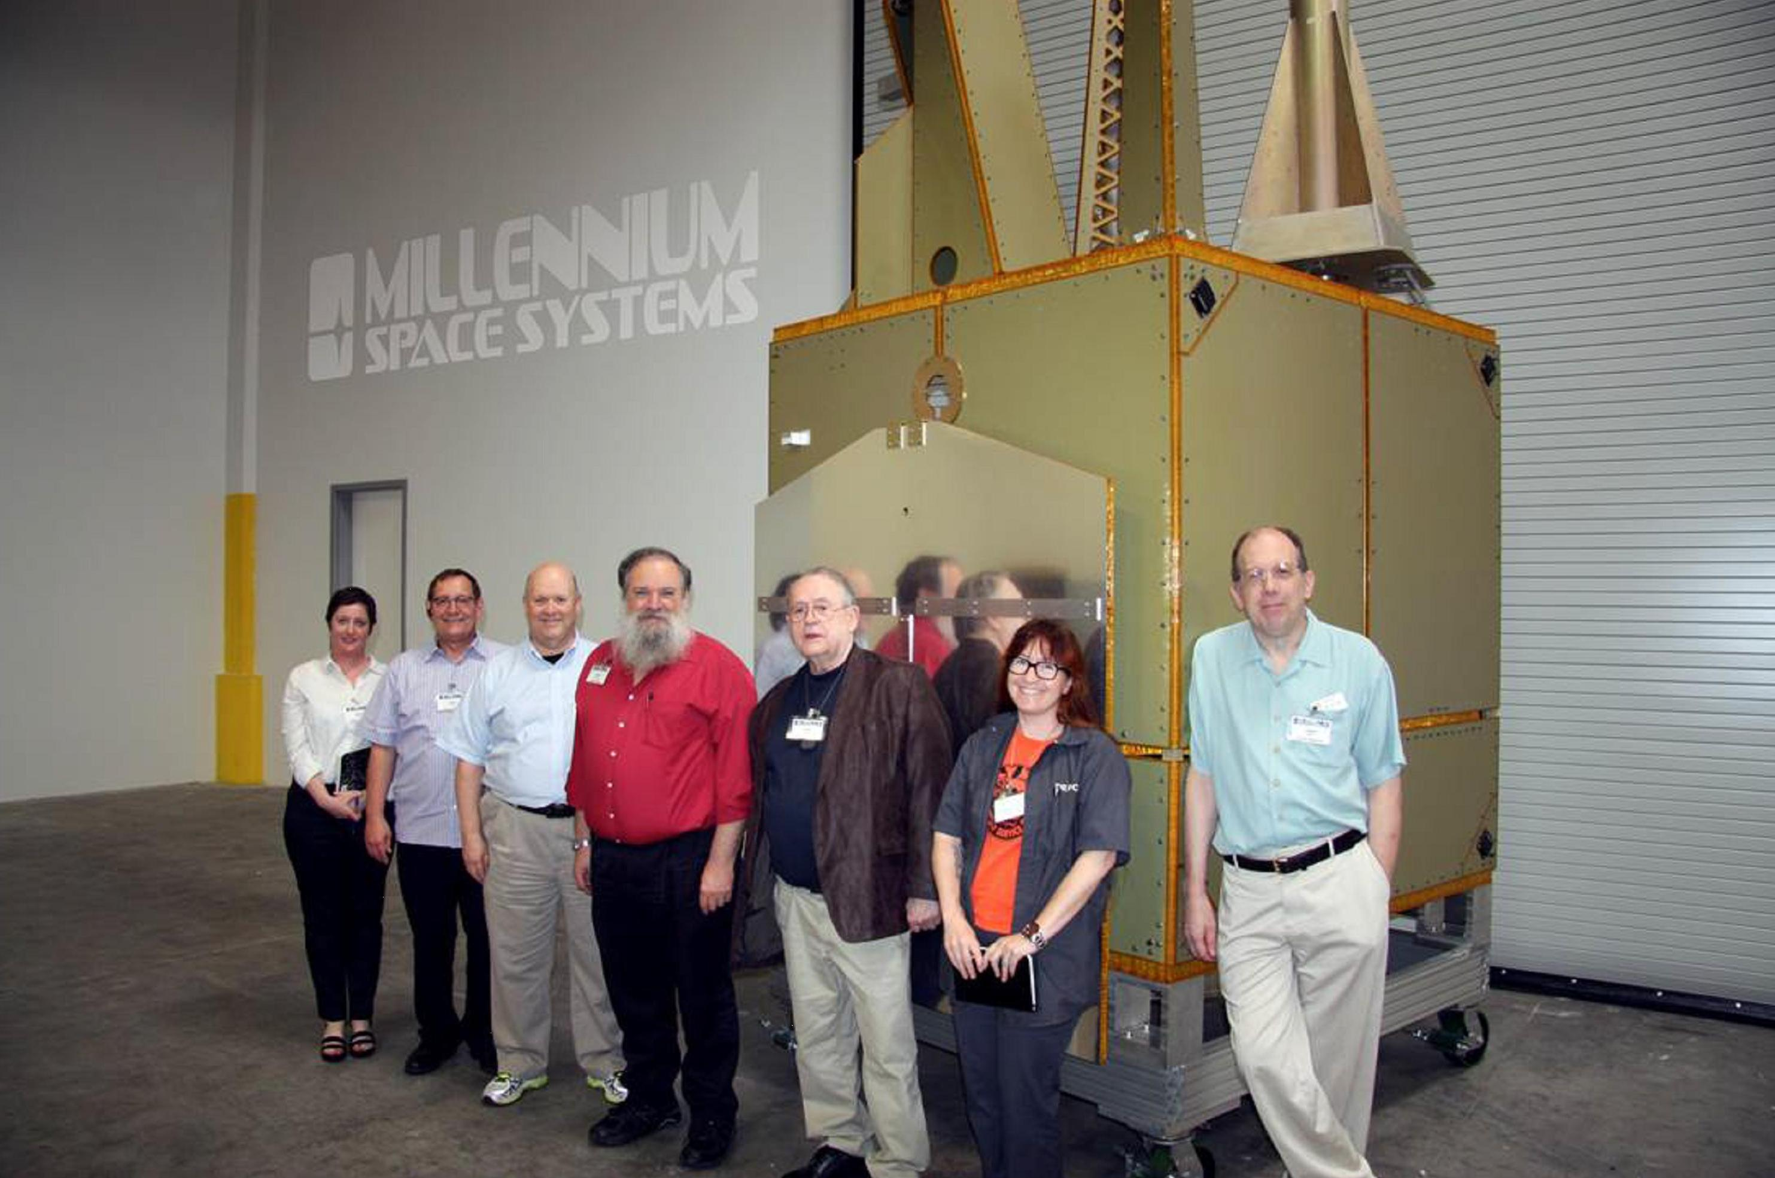
USAF WFOV Satellite
Notes:
(L-R) Sonya Rowe, KK4NLO; Jerry Buxton, N0JY; Bob McGwier, N4HY; Franklin Antonio, N6NKF; Tom Clark, K3IO; Michelle Thompson, W5NYV; and Phil Karn, KA9Q standing next to the Aquila M8 Bus flight article. (Click photo for larger image.)

Slide 26
PHASE 4B
Five and Dime (5GHz up 10Ghz down)
Software Defined Radio
ALL DIGITAL – No Analog Transponder
Digital Regenerative Repeater
Geosynchronous Orbit (Not Geostationary)
Launch Date presently uncertain.
Notes:
Phase 4B has a Rideshare but the Primary is currently delayed.
Alternative rideshares are being pursued but cannot be discussed.

Slide 27
Phase 4B Downlink
10.450 GHz Carrier
Single Downlink
Saturated Power Amplifier (maximize DC efficiency)
Up to 8+ Megasymbols per Second
DVB-S2 Modulation
ALL Stations synchronize to the downlink
Stations Decode streams they want (including all)

Slide 28
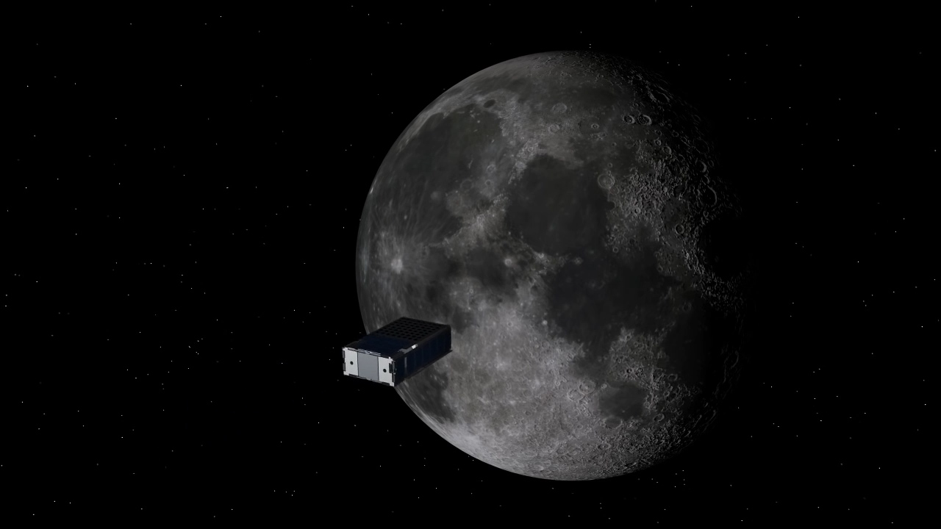
PHASE 5 – NASA CUBEQUEST CHALLENGE
RAGNAROK INDUSTRIES - HEIMDALLR
Notes:
AMSAT has been partnering with Ragnarok Industries to supply the communications payload for their Heimdallr Satellite
Entry for the cubesat challenge. Heimdallr was in the top 5 of 100 entries but was not awarded one of the 3 rideshares and remains as alternate.
AMSAT continues to support Ragnarok should it move forward as a Standby.

Slide 29
Phase 4B Uplink
5 GHz Band
10 MHz Receive Bandwidth at transponder
Stations use 10kHz to 100kHz Bandwidth
Modest Power Required 2W – 10W
Modulation 4-ary MFSK (constant envelope)

Slide 30
Notes:
The US Military already has a constellation of operational COMM satellites called MUOS. Mobile User Objective System.
The three operational satellites provide global coverage (with a 4th on orbit spare).
Four ground stations or Radio Access Facilities (RAF) each have 2 satellites in view. Each satellite can see two RAF’s.

Slide 31
Notes:
MUOS Terminals operate in UHF for both uplink and downlink.
RAFs Operate in Ka band.
Two hops are always required.

Slide 32
2.4 GHz
10.5 GHz
Notes:
Phase 4A may be able to be used in a ground repeater mode. Conceptually similar to MUOS.
The narrow band uplinks are received by a central Earth Station, Multiplexed into a DVB-S2 carrier, which is uplinked.
All small stations transmit on 2.4 and receive on 10.5 GHz

Slide 33
Why DVB-S2
DVB Standards are International, Free, and very widely used.
DVB-S2 is the 2nd Generation Standard
Generic Stream Encapsulation (GSE) used for the downlink data.

Slide 34
DVB-S2 Features
Continuous Transmission of frames at symbol rate.
Modulation and Coding (MODCOD) can vary with each frame.
Very Powerful Forward Error Correction (FEC)
Low Density Parity Check (LDPC) codes are nearly ideal. Amateur radio has access to open source implementations.

Slide 35
Repeater Mode Advantages
Only DVB-S2 Receiver Required. (No need for existing transceiver and transverter)
Simple Digital Transmitter on 2.4GHz uplink, 2W
Digital Voice
Expensive Equipment only at Central Station
Coexistence with Analog Modes

Slide 36
Future
Future GEO’s will have onboard regenerative repeaters eliminating need for central ground station.
Ground Repeater Software developed for Phase 4A will be useful for future satellites with onboard repeaters.
3 on-orbit satellites could eventually provide global coverage.

Slide 37
Get Involved
Phase 4 Space
https://phase4space.github.io/
Phase 4 Space
Open to everyone worldwide
Active daily through collaboration tools (Slack, email list, github repository)
Focus on Satellite + Terrestrial Microwave
https://phase4ground.github.io/

Slide 38
Questions and Discussion

